Slide 1
Python 101
Erin Hayward-Lang
Women in Tech Committee
BSc Physics
MSc Business Analytics
Notes:
Good Morning everyone! Welcome to Python 101.
My name is Erin and I’m going to be leading this quick session on the basics of Python. I know a lot of you probably have at least experience coding in Python, so this will be just a refresher on the basics for people who have less experience. Feel free to zone out and prepare for the rest of the day if this isn’t going to be much use for you!
So a bit of background on myself quickly, I joined the Women in Tech committee this year and we are so thrilled to be able to help out at this event because it’s really a first of its kind. Last summer I graduated from my bachelors in Physics and stayed in Bath to study for a masters in Business Analytics. Over the past 5 years I have used a fair few different coding languages, Python being the one I chose to use for my final year project in Physics.

Slide 2

Agenda
What is Python?
Syntax, Variables & Data Types
Built-in Functions, Modules & User Defined Functions
For, While, If, Else
Object-Oriented Programming

Slide 3
What is python?

Slide 4
What is Python?
Python is a high-level coding language - this means it hides away the underlying details of the computers hardware and provides a human-readable way of coding. They are much easier to learn in comparison to low level languages (such as C)
Python can be used for a wide range of tasks, from simple scripts to complex applications, and it has a vast library of modules and packages that makes it easy to perform a variety of tasks.
Strong community of users and developers. Python has a large and active community of contributors who maintain and update the language, libraries, and tools, making it a stable and well-supported platform.
Notes:
Python is a high-level coding language. This means it hides away the 1’s and 0’s of the computers hardware and provides a human-readable way of coding. They are generally much easier to learn than low level languages such as C.
One of the reasons for Python's popularity is its versatility. Python can be used for a wide range of tasks, from simple scripts to complex applications, and it has a vast library of modules and packages that makes it easy to perform a variety of tasks. Additionally, Python's syntax is simple, intuitive, and easy to learn, making it a popular choice for beginners and experienced programmers alike.
Another reason for Python's popularity is its strong community of users and developers. Python has a large and active community of contributors who maintain and update the language, libraries, and tools, making it a stable and well-supported platform.

Slide 5
Why is Python great?
Easy to learn and use
Versatile
Strong community
Cross-platform
Easy to integrate with other technologies
Notes:
Easy to learn and use: Python's simple and intuitive syntax makes it a great language for beginners to learn. It is designed to be easy to read and write, and it requires fewer lines of code to perform the same tasks compared to other programming languages.
Versatile: Python can be used for a wide range of tasks, such as web development, scientific computing, data analysis, artificial intelligence, and more. Its vast library of modules and packages makes it easy to perform a variety of tasks, and its interpreted nature makes it possible to quickly test and iterate code.
Strong community: Python has a large and active community of contributors who maintain and update the language, libraries, and tools, making it a stable and well-supported platform.
Cross-platform: Python can run on multiple platforms, including Windows, macOS, and Linux, making it a flexible choice for a variety of projects.
Easy to integrate with other technologies: Python can easily interface with other technologies, such as databases, web services, and other programming languages, making it a great choice for building complex applications that involve multiple components.

Slide 6
Syntax, Variables & Data Types

Slide 7
Syntax
# This is a comment
’’’
3 apostrophes make a
multi line comment block
’’’
if 5 > 2:
print(“5 is bigger!”)
if 5 > 2 and month == ”May” \
and day <= 12:
print(”That’s useless”)
Syntax is how the code is structured
# and ‘’’ can be used to make comments
Indentation is important to separate blocks of code – you will get an error if you don’t indent correctly! The amount you indent is up to you, and you can space or tab.
Backslash \ is used to indicate line continuation if your code is too long for one line. You can also use brackets!
Notes:
Syntax generally means how a code is structured and used correctly. In python we can use hashtags or appostrophes to make comments in your code. This is important to remember what steps you’ve taken!
Indentation is really important in python as it can throw an error if not done correctly. It’s quickest to just tab when you start a new code block, this is a big enough gap so that its clear where each block starts and ends.
Backslash can be used to continue a long line of code onto the next line, without the computer being confused as to what you’re doing. If you’re writing something inside brackets this will be done automatically so that’s good practice.

Slide 8
Variables
# Two different variables!
name = “John”
Name = “Andrew”
x = 3
# x is of type int
x = str(3)
# x is of type str, so ‘3’
x = float(3)
# x is of type float, so 3.0
# get the type of your variable
print(type(x))
Variables are case sensitive.
Variables do not need to be declared with a type – however you can cast it to be a specific type.
Variables will be overwritten if you declare it twice.
You can use single or double apostrophes for strings.
Notes:
Variables are a key part to any coding language. In python variables are case sensitive, so you can see here name and Name are two different variables – but don’t do this!
Variables do not need to be declared with their type, but we can cast them to be a specific type if that’s needed, shown here with the different examples of x = 3.
Variables are overwritten when theyre declared again later in code and strings can be made using either single or double apostrophes.
I’ll head onto in-built functions later but if you’re unsure of what type a variable is you can check using this code.

Slide 9
Data Types
Text Type - string str x = “hello world”
Numeric Type - integer int x = 20 - float float x = 20.5 - complex complex x = 20j
Sequence Type - list list x = ["apple", "banana", "cherry"] - tuple tuple x = ("apple", "banana", "cherry") - range range x = range(6)
Notes:
So from data types here are the different data types in Python. There are more than this but I tried to pick ones which were most significant.
The text type is known as a string. Numeric types are integers, floats and complex, floats is basically anything with a decimal and complex is then complex numbers.
Sequence types are lists, tuples and range. Lists are dynamic and can be appended and modified (mutable) but tuples cannot be changed once they have been created (they’re immutable) however tuples are faster.
The range() function returns a sequence of numbers, starting from 0 by default, and increments by 1 (by default), and stops before a specified number – useful for loops!

Slide 10
Data Types
Mapping Type - dictionary dict x = {"name" : "John", "age" : 36}
Set Type - set set x = {"apple", "banana", "cherry"}
Boolean Type - boolean bool x = True
None Type - None NoneType x = None
Notes:
Dictionaries are used to store data values in key:value pairs. A dictionary is a collection which is ordered*, changeable and do not allow duplicates.
Sets are used to store multiple items in a single variable, written with curly brackets.
Boolean type is the standard true/false and none type is just none.

Slide 11
Built-in Functions, modules & User- defined functions

Slide 12
Built-in Functions vs. Modules
Built-in Functions
Modules
A function that is available to the programmer without having to import any additional modules.
For example, the print() function is a built-in function that is always available in Python.
Documentation for all built-in functions can be found online.
Useful ones: len(), type(), help()
Collections of functions, classes, and other code that can be imported into a Python script for use.
Lots of packages can be installed from online with lots of different functions.
import math x = math.sqrt(16) print(x)
Notes:
In Python, the difference between a built-in function and a module is that built-in functions are functions that are included with the Python language and are available for use without having to import anything. Modules, on the other hand, are collections of functions, classes, and other code that can be imported into a Python script for use.
For example, the print() function is a built-in function that is always available in Python, while the math module provides a collection of mathematical functions, such as square roots, trigonometric functions, and more.
Once you have imported the math module, you can then use its functions in your code.

Slide 13
User-Defined Functions
# greet a person
def greet(name):
print("Hello, " + name + "!")
greet("John")
# square a number
def square(x):
return x * x
result = square(5)
print(result)
# import your own functions
from myfuncs import *
These functions that you create yourself, as opposed to the built-in functions available to everyone.
Allow you to encapsulate a piece of code that you want to reuse multiple times in your program, and to abstract away complex logic into a simple and easy-to-use function.
Return a value using the return keyword.
You can save functions in a different .py file and import into your script.
Notes:
User defined functions are a key part of programming, allowing the user to build their own functions which can be called multiple times during a script. They can be saved into a different .py file and imported into a script too to make things cleaner. Here’s two very simple examples of a user defined function, both of them have an input argument which is then used in the function. The function doesn’t have to have an input argument but a lot of the time it does.

Slide 14
For, While, IF, ELse

Slide 15
For and While
# print each element of the list
fruits = ["apple", "banana", "cherry"]
for fruit in fruits:
print(fruit)
’’’
can also use:
for i in range(len(fruits))
‘’’
# print 0 1 2 3 4
count = 0
while count < 5:
print(count)
count += 1
Loops are a key part of any programming language.
The code block within the for/while statement will repeat while that statement holds true.
When working with more dynamic variables we can make use of built-in functions like range(len()) to loop over the size of an array.
Notes:
For and While loops are a key part of any programming language. The code block within the for or while statement will repeat while that statement holds true.
This For loop example is basically saying print each element of the list fruits, so for each fruit in fruits, print fruit. We can also use the example below with range and len which is going to return the range of the length of fruits as an integer so the computer knows how many steps to take.
The while loop example executes the indented code block as long as count is less than 5. The value of count is incremented by 1 at the end of each iteration, so that eventually the condition becomes false and the loop terminates. You can see the counter has been initiated as 0.

Slide 16
If and Else
x = 5
if x > 10:
print("x is greater than 10")
elif x > 0:
print("x is positive but not greater than 10")
else:
print("x is not positive")
# What’s the Answer?
# “x is positive but not greater than # 10”
if statements tell the computer to execute a block of code if the condition is true.
else statements tell the computer what to do if the condition is not true.
elif allows you to make more cases in your statement to check for, then the final else will run if none of the elif conditions were true.
Notes:
if and else statements in Python are used to control the flow of execution based on certain conditions. An if statement allows you to test a condition, and if the condition is true, execute a block of code. The else statement allows you to tell the computer what to execute if the condition isn’t true, instead of it just doing nothing.
It's possible to chain multiple if-else statements together to handle more complex conditions. In this example, the code first tests whether x is greater than 10. If it is not, it then tests whether x is greater than 0, and if it is, it prints the message "x is positive but not greater than 10". If neither of the conditions are true, the code in the else statement is executed, printing the message "x is not positive".

Slide 17
Object-Oriented Programming

Slide 18
What is it?
Object-oriented programming (OOP) focuses on creating objects that have both properties (attributes or variables) and behaviour (methods or functions) and can interact with each other to solve a particular problem.
The objects in an OOP program are instances of classes, which are like blueprints for creating objects. A class can have data attributes that represent the properties of the object, and methods that represent the actions that the object can perform.
OOP is widely used in software development because it allows you to create code that is easier to understand, maintain, and modify.
Notes:
Read slides
Python is an object-oriented language, which means it has built-in support for creating and working with objects.

Slide 19
OOP in Python
Here we create a class in Python with 3 data attributes.
All classes have a function called __init__(), which is always executed when the class is being initiated.
my_car is an instance of the car class, so we can access its attributes and call its methods.
class Car:
def __init__(self, make, model, year):
self.make = make
self.model = model
self.year = year
def start(self):
print("The car is starting")
my_car = Car("Ford", "Mustang", 2022)
# prints "Ford"
print(my_car.make)
# prints "The car is starting” – this is how you call a class’ method
my_car.start()
Notes:
In this example, we've defined a class called Car, which has three data attributes (make, model, and year) and one method (start). The __init__ method is a special method that is called when an instance of the class is created, and it is used to initialize the data attributes.
To create an instance of the Car class, we can call the class like a function, passing in the required arguments
Now, my_car is an instance of the Car class, and we can access its data attributes and call its methods
Object oriented programming is super important when it comes to using packages so if you don’t know how to make a class, just know how to use it!

Slide 20
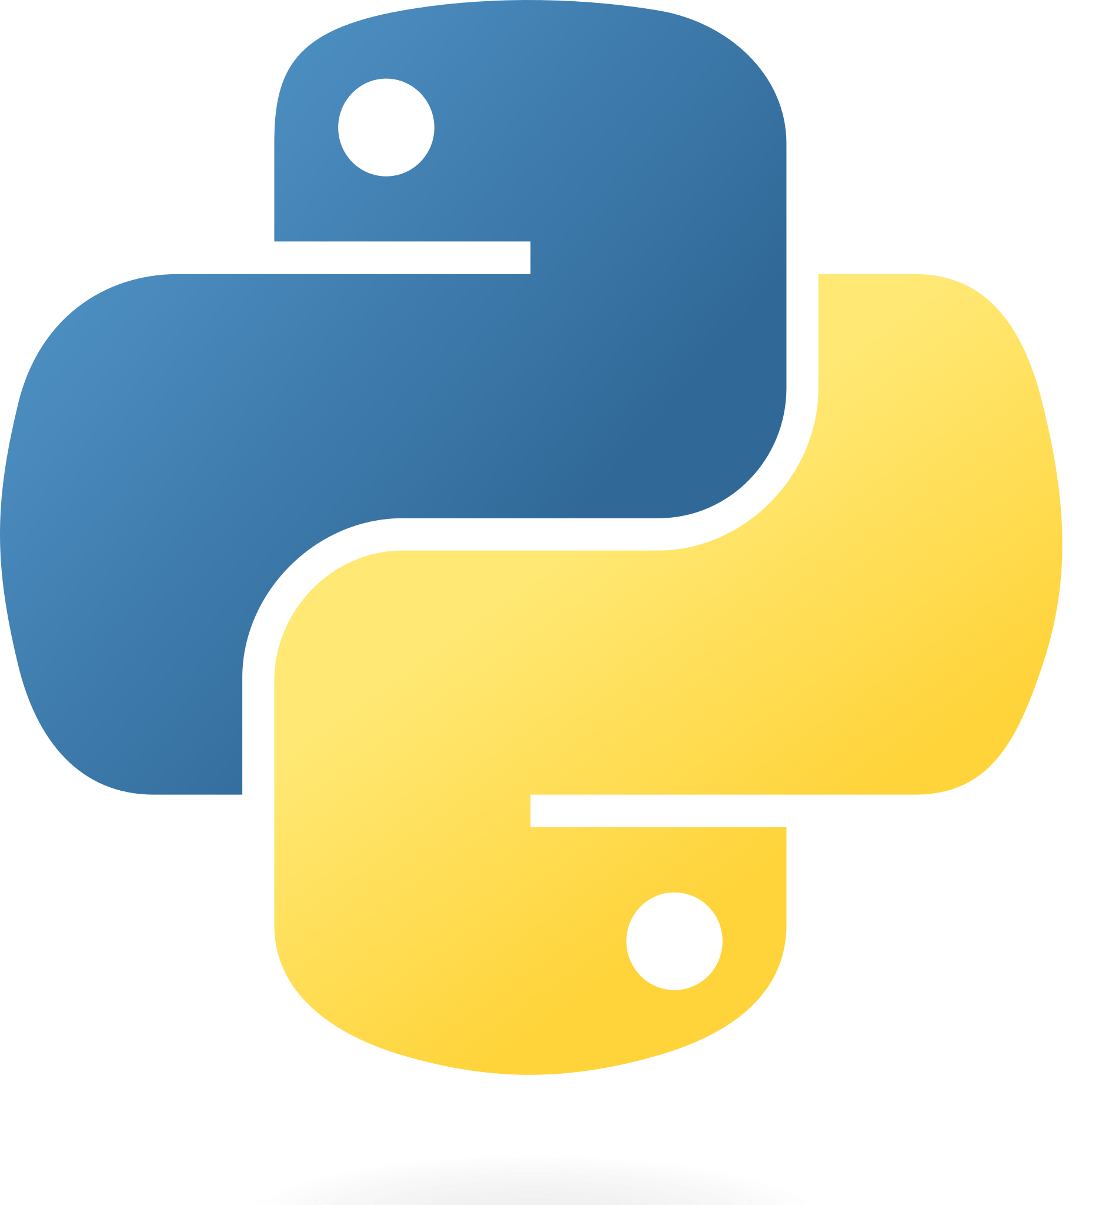
There’s plenty of resources available online! https://docs.google.com/document/d/1XqyITHP75sF6j2bIqAMaOxnHnSNZJ6FrmdIw5YaeeDo/edit

Slide 21




Thank you & Happy coding!
Erin Hayward-Lang
eshl21@bath.ac.uk

